Slide 2


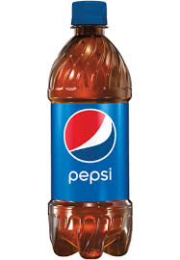

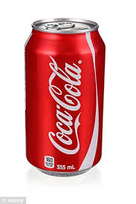
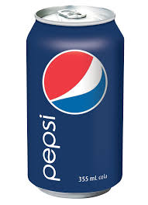
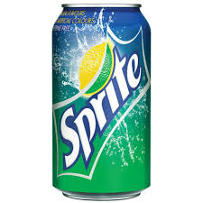
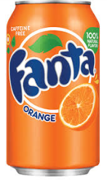
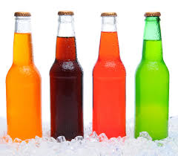
Source
Target
A model built from
plenty of source data
Source
Model
Lots of unlabeled data
And a few labeled ones

Slide 4
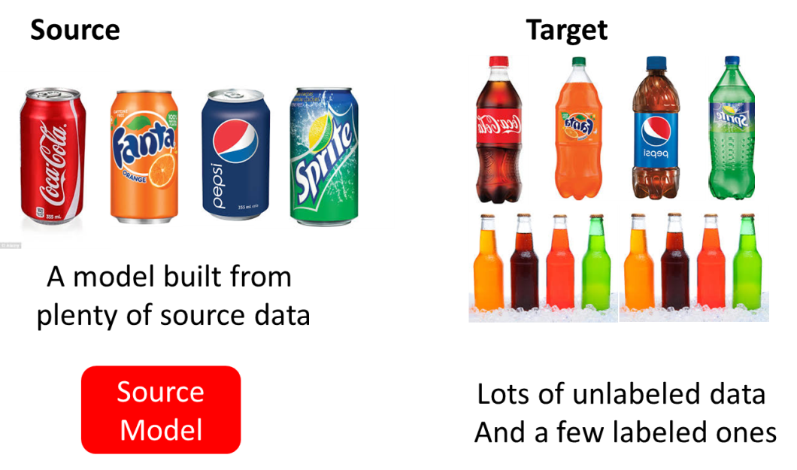
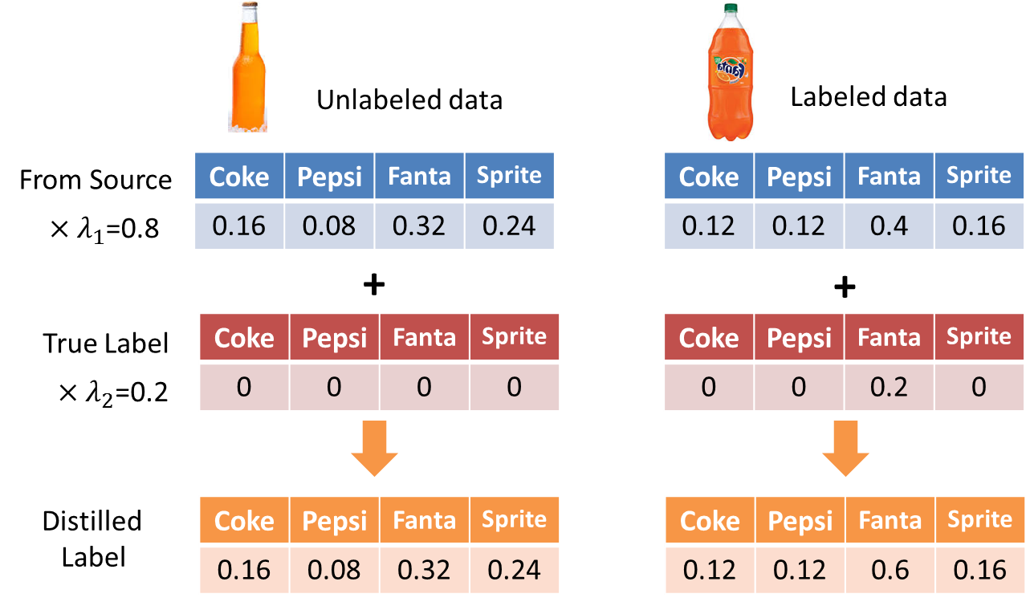
Task
Solution

Slide 6



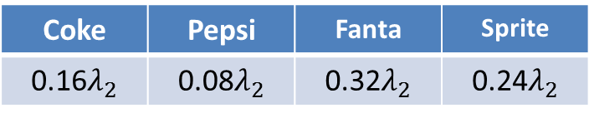
Labeled data
Unlabeled data
Coke | Pepsi | Fanta | Sprite
0.2 | 0.1 | 0.4 | 0.3
From Source
Imitation Parameter
$$×λ_{2}$$
Coke | Pepsi | Fanta | Sprite
0.16$λ_{2}$ | 0.08$λ_{2}$ | 0.32$λ_{2}$ | 0.24$λ_{2}$
+
+
True Label
Coke | Pepsi | Fanta | Sprite
0 | 0 | 0 | 0
Coke | Pepsi | Fanta | Sprite
0 | 0 | 0.2 | 0
$×λ_{2}$=0.2
Distilled
Label
Coke | Pepsi | Fanta | Sprite
0.16 | 0.08 | 0.32 | 0.24
Coke | Pepsi | Fanta | Sprite
0.12 | 0.12 | 0.6 | 0.16
How to solve the Imitation Parameter

Slide 7


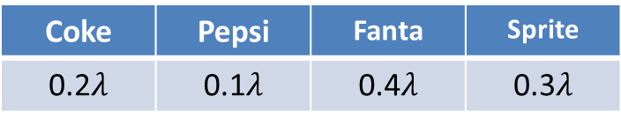
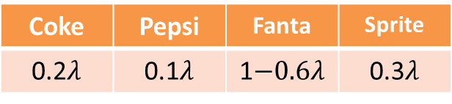
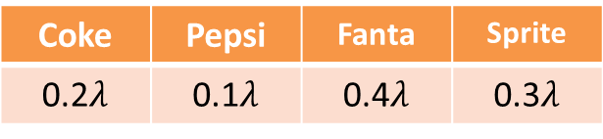
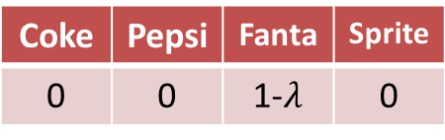
From
Source
Coke | Pepsi | Fanta | Sprite
0.2 | 0.1 | 0.4 | 0.3
$×$ Imitation Parameter $λ$
Coke | Pepsi | Fanta | Sprite
0.2$λ$ | 0.1$λ$ | 0.4$λ$ | 0.3$λ$
Unlabeled data
Labeled data
Coke | Pepsi | Fanta | Sprite
0 | 0 | 0 | 0
Coke | Pepsi | Fanta | Sprite
0 | 0 | 1-$λ$ | 0
True
Label
$×$ (1$−λ)$
Coke | Pepsi | Fanta | Sprite
0.2$λ$ | 0.1$λ$ | 0.4$λ$ | 0.3$λ$
Coke | Pepsi | Fanta | Sprite
0.2$λ$ | 0.1$λ$ | 1$−0.6λ$ | 0.3$λ$
Distilled Labels

Slide 8
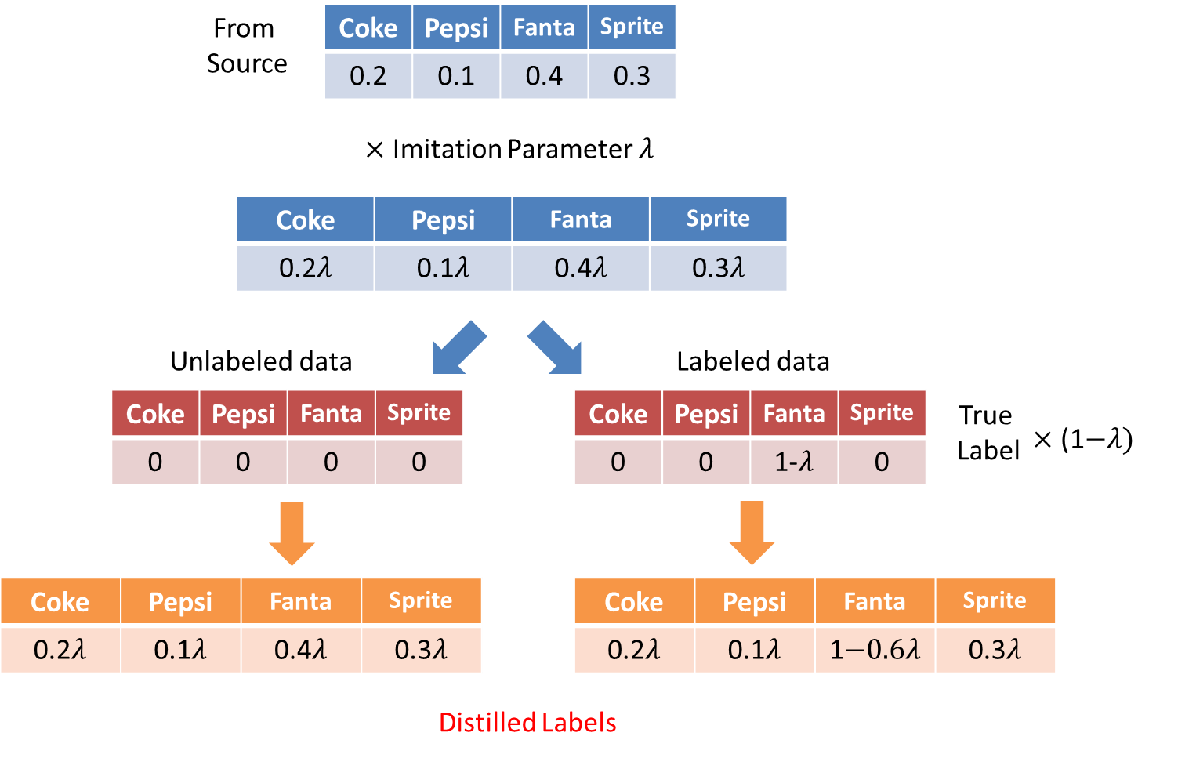
Training
X
Distilled Label
Target
Model
How to Solve the
imitation parameter ?
Testing
Example
Target
Model
Prediction

Slide 9
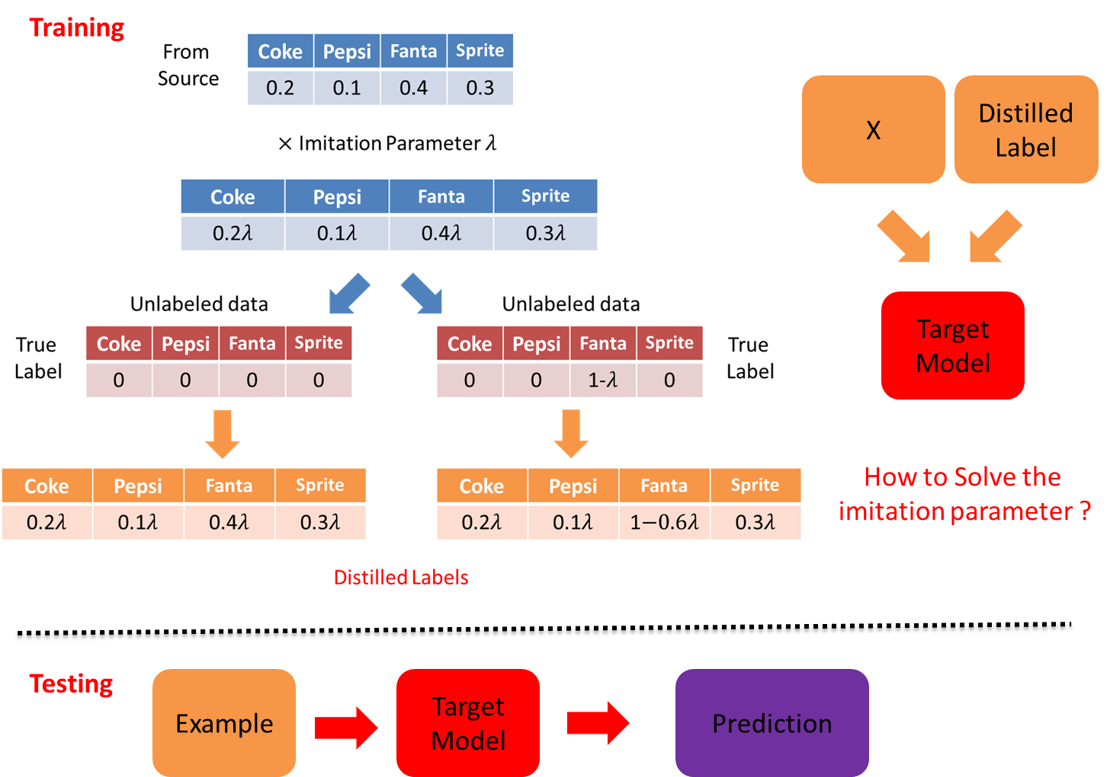
Task

